Slide 1
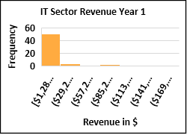
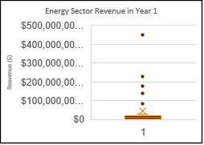
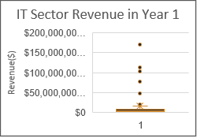
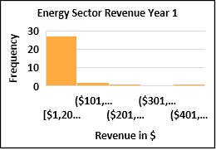
Do companies in Energy Sector make more revenue in Year 1 compared to IT sector companies in their Year 1?
The histograms along(down) show Year 1 Revenues for Energy and IT Sectors Respectively. Both are right skewed, meaning that the average(mean) revenue is greater than the median.
The two visuals on top are box plots
The mean revenue for Energy sector is $43.6B while that of IT is $15.5B. From the look on both data sets, we have outliers in the data, hence we will rely on the median to compare the two sectors.
The Median revenue for Energy sector is $11.97B while that of IT is 4.43B.
More than 75% of Energy sector companies are earning a revenue of $21.2B, while the IT sector earn a revenue of $8.8B.
The standard deviation of revenue in the Energy sector is $91B while that of IT is $30.6B, meaning that there is more variabilty in the Energy sector.This might be explained by the outliers in the data which make the mean not so reliable.If we remove the outliers, we are likely to get a more reliable standard deviation.
We can conclude that Energy Sector revenues are higher than IT sector revenues for Year 1 Of operation

